Slide 2
Mrs. Alverson saalverson@madisoncity.k12.al.us
Mrs. Doughty ldoughty@madisoncity.k12.al.us
Mrs. Gowan megowan@madisoncity.k12.al.us
*Mrs. Harmon annaldennis@madisoncity.k12.al.us
Mrs. Hill crhill@madisoncity.k12.al.us
Mrs. Hyatt ahyatt@madisoncity.k12.al.us
Mrs. Wells akwells@madisoncity.k12.al.us
Please don’t hesitate to contact us with questions or concerns!

Slide 3
Communication Tools:
O.W.L. Binders
Daily Communication Binders come home every afternoon and are returned to school every morning. Please send any notes, money, permission slips, etc. for the teacher in the binder.
Occasionally we will send time sensitive notes
Tuesday Folders
Graded papers, important notes, forms will come home on Tuesdays. Please return on Wednesday.
Weekly Newsletters/Study Guides
You will receive an email every week containing all the news and information you need for the week.

Slide 4
Transportation Changes
Please send a note if your child will have a change in transportation.
Unexpected changes- call the office before 1:45. Please do not email teachers about transportation changes. (If I do not reply to your email or DOJO Message, I DID NOT receive it. Call the office ☺)

Slide 5
https://connected.mcgraw-hill.com/connected/login.do
Weekly lesson from the Wonders series
Spelling pattern tests on Thursdays
Reading tests on Fridays (comprehension, phonics, language, and grammar assessments are embedded)

Slide 6
Application of Spelling
As stated in each of the grade level standards, the expectation is that appropriate spelling be utilized as children write.
As a result, traditional spelling test will no longer be used to assess writing.
Spelling will be graded through dictation sentences and/or writing artifacts to ensure the application of spelling is applied when the students write.

Slide 7
Spelling Instruction
Spelling will continue to be instructed in every classroom regularly using phonics patterns, syllabication, base words, etc.
A list of words may be sent home as example words to follow when studying, but the exact words may not be used on the assessment. However, similar words will be used that follow the same pattern or rule. Again, the purpose of the assessment is to measure the application of the spelling focus to ensure students carry that skill over to other facets.

Slide 8
EnVision
Fact Fluency (including weekly timed tests)
Problem Solving/Journaling
Math Talks
XTRA math
Take time to practice telling time, counting money, counting to 1,000

Slide 9
Science/Social Studies
AMSTI Science Topics
Plants and Bugs
Matter
Soils and Shores
Social Studies
Studies Weekly
Communities, Our Country, Geography

Slide 10
Assessments
STAR Reading and Math (5 times/year)
FRY sight words (3 times/year)
DIBELS (3 times/year)
Requirements:
51 wpm in August
73 wpm in December
94 wpm in May

Slide 11
2nd grade
Dibels 8th edition: dynamic Indicators of Early Literacy Skills
Given three times a year
Fall
Winter
Spring
Nonsense Word Fluency (NWF)- Tests letter-sound correspondence in which letters represent their most common sounds and of the ability to blend letters into words. (e.g., sig, rav, ov)
Word Reading Fluency (WRF)- Students read individual words aloud from a word list printed on a sheet of paper for one minute.
Oral Reading Fluency (ORF)- Students performance is measured by having students read a grade level passage aloud for one minute.

Slide 12
What is a Standards-Based Report Card?
Clearly communicates what we want students to learn and be able to do
Communicates students’ level of progress or proficiency in meeting grade level standards based on end of the year goals
Communicates progress without utilizing a traditional grading system

Slide 13
How is academic progress measured?
4- Demonstrates an understanding of the standard independently
3- Demonstrates an understanding of the standard with minimum supports
2- Demonstrates an understanding of the standard with continuous supports
1- Does not demonstrate an understanding of the standard

Slide 14
What does Progress towards Mastery of Individual Grade Level Standards look like?
Grade Level Standards are end of the year goals
Expected to be met independently by each student before the end of the school year
Progress towards end of year goals may vary from student to student
Parent Guide explains standard requirements.
- All second grade standards included on the Parent Guide
Some report card standards have other standards embedded within
The reason is to keep parents informed without reporting on every individual standard. If the overarching standard can be performed independently, most often the supporting standards can be as well. If your child is having difficulty with a standard, you can reference the Parent Guide to better understand what that particular standard consists of or reach out to your child’s teacher for guidance.

Slide 15
What other information is included on the Report Card?
Behaviors the Support Learning
S – Satisfactory - Consistently demonstrates the behavior
N – Needs Improvement – Inconsistently demonstrates the behavior
U – Unsatisfactory - Rarely demonstrates the behavior and learning is affected
Science, Social Studies, Health, Technology, Spanish, Art, Music, PE
S – Satisfactory - Consistently participates
N – Needs Improvement – Inconsistently participates
U – Unsatisfactory - Rarely participates

Slide 16
How will parents be notified of your child’s progress?
Progress Reports will go home every 4 ½ weeks, except during the first nine weeks. Progress reports will be sent home after the first six weeks of school during the first nine weeks.
Reports Cards will be sent home at the end of each grading period.
Grading Period Ends
1st Nine Weeks – October 4, 2019
2nd Nine Weeks – December 20, 2019
3rd Nine Weeks – March 2, 2020
4th Nine Weeks – May 21, 2020
Report Cards Sent Home
1st Nine Weeks – October 21, 2019
2nd Nine Weeks – January 9, 2020
3rd Nine Weeks – March 16, 2020
4th Nine Weeks - May 21, 2020

Slide 17
Gifted services in Madison City
Definition of Gifted
Intellectually gifted children and youth are those who perform or who have demonstrated the potential to perform at high levels in academic or creative fields when compared with others of their age, experience, or environment. These children and youth require services not ordinarily provided by the regular school program. Children and youth possessing these abilities can be found in all populations, across all economic strata, and in all areas of human endeavor. Gifted students may be found within any race, ethnicity, gender, economic class, or nationality. In addition, some students with disabilities may be gifted. Madison City Schools shall prohibit discrimination against any students on the above basis with respect to his/her participation in the gifted program.

Slide 18
Provided Gifted services
Consultation services offered for K-2.
Collaboration services for general education teachers across grade levels concerning meeting the needs of high-end learners in the general education classroom.
Second Grade Child Find: All second graders are observed throughout their second grade year using state mandated protocol.
Pull out services for grades 3-5:
Students can be referred for screening at any time from 3rd-5th grade by teachers, counselors, administrators, parents or guardians, peers, self, and other individuals with knowledge of the student’s abilities. These pullout services provide curriculum that is concept and problem based as well as provide the social and emotional support gifted learners often need.
6th grade Innovative Explorations course offered for gifted qualified students.
Advanced courses offered for grades 7-12.

Slide 19
*Math Sheet
*Reading Sheet
*Read 2 Books
**Two AR tests are required per week**
*Homework is sent out Monday and is to be turned in Friday mornings

Slide 20
Accelerated Reading (AR)
Student reading levels are based on the STAR Reading assessment.
Students are expected to take a minimum of two AR tests per week with a 90% average or better.
Students will be assigned AR point goals every nine weeks.
You can monitor your child’s progress by signing up on the RenPlace website to receive email updates.
https://hosted9.renlearn.com/1355888/HomeConnect/Login.aspx

Slide 21
Our Class wig
Our class WIG is to have 85% or more of all students reach their personal reading goal this 9 weeks.

Slide 22
Online Resources
Stay tuned for more details

Slide 23
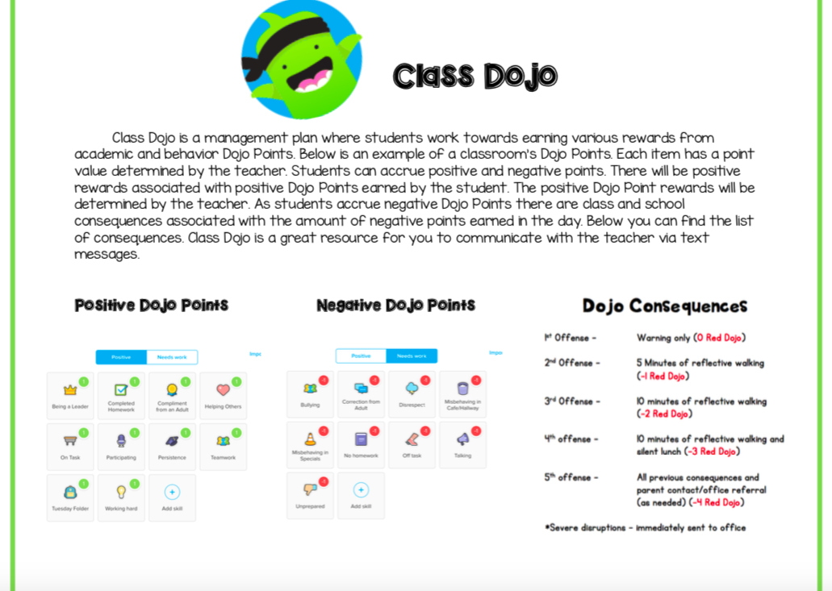
Class Dojo
Treasure Box
Classroom Table points

Slide 24
PTA and volunteer opportunities
Please join and support our wonderful PTA!
Stay tuned for details from our room mom about volunteer opportunities.

Slide 25
Expanded Day
Registration for full-time, part-time, and drop-in services can be found on the Heritage website and the front office.

Slide 26
Carline procedures
Make sure your child knows his/her car rider number.
Drive slowly
No cell phones
Pull forward
Do not get out of your car
If your child needs help getting buckled, pull into the parking lot.

Slide 27
Visiting for lunch?
You and your child may sit at the tables labeled for parents. Please do not invite other students to eat with you. These tables of honor are for you to have special time with your child.
You may bring lunch for your child, but please do not bring lunch for other children.
For birthdays you are welcome to purchase ice cream for the class. The cost is $.75 per child. Outside treats are not allowed.

Slide 28
Winter Holiday party
End of the Year party

Slide 29
Field trips (tentative plans)
Local School Play
Lyon Family Farm
Possible 3rd Field Trip To Be Determined

Slide 30
Senora Joelle Jones
Madison City Schools
Elementary Spanish

Slide 31
What does Spanish look like in Madison city schools?
Our Vision Through fun, engaging, and meaningful classroom experiences Madison City’s K-4th graders will begin their journey on the path to proficiency in the Spanish language. | When Students have Spanish once a week for 30 minutes for the whole year. Who All students K-5th grade!
The Program The program started in January of 2014 with two teachers teaching K-1st grade. This year the program has added 5th grade with a total of six teachers spread out across the district’s seven elementary schools. | How Teachers use gestures, motions, and pictures to ensure the language is comprehensible to students. Lessons are fun and engaging through the use of songs, games, and active learning. Teachers strive to meet ACTFL’s goal of 90% in the target language.

Slide 32
What will we learn in second grade
Exploration of the cultures of Costa Rica, Puerto Rico, Dominican Republic, Guatemala, and Cuba
Answer simple Yes/No and Either/Or Questions in Spanish
Commonly used vocabulary (greetings, colors, body parts, family, animals, foods, weather, clothing, seasons, numbers, days of the week, and month

Slide 33
7:25-8:15 Morning Procedures
8:15-9:30 Reading
9:30-10:00 PE
10:00-10:45 Phonics
10:45-11:10 Recess
11:10-11:35 Lunch
11:35-1:05 Math
1:05-1:15 Snack
1:15-2:00 Science
2:00-2:35 Social Studies
2:35-2:45 Clean up/Dismissal

Slide 34
Class Mission Statement
The Mission of Class 304 is to show each other kindness and respect. We strive to follow all expectations. We have fun while doing what is right. We care for each other, are friendly and safe. We are a room full of LEADERS!

Slide 35
Thank you for being here!
It is going to be an amazing year!
*Please make sure to write your child a note and leave it on his/her desk (see Mrs. Harmon for paper)*

